Slide 1
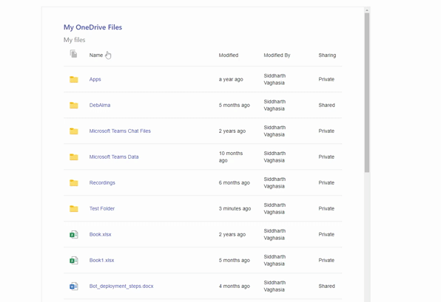

SPFx webpart to display current user’s One Drive files
react-myonedrive
Siddharth Vaghasia (@siddh_me)

Slide 2








Siddharth Vaghasia
Independent Consultant
https://siddharthvaghasia.com
https://c-sharpcorner.com/members/siddharth-vaghasia
@siddh_me
siddharth-vaghasia
https://www.linkedin.com/in/siddharthvaghasia

Slide 3

react-myonedrive
SPFx webpart to display current user’s One Drive files
https://github.com/pnp/sp-dev-fx-webparts/tree/main/samples/react-myonedrive

Slide 4
Driving factor
A web part for Intranet Landing Page or Viva connections ? ☺
Way to show personalized content for current logged in user
Explore One Drive Graph API and it usage

Slide 5
Summary
Show current user's OneDrive Files
Browsable folder and files
Support to display icons for most known file types.
Breadcrumb as in OneDrive App to quickly navigate
Sorting based on Name and Modified Date column
Options to choose fields to be displayed from Name, Modified, Modified By, File Size, Sharing
Option to make web part title link clickable to send to OneDrive URL

Slide 6
Demo/ Code Walkthrough

Slide 7
THANK YOU

